Slide 1
Chapter Exercise 1.69
CUNY MS DATA SCIENCE FALL 2018
John K hancock

Slide 2
Side Effects of Avandia
Rosiglitazone is the active ingredient in the controversial type 2 diabetes medicine Avandia
Rosiglitazone has been linked to an increased risk of serious cardiovascular problems such as stroke, heart failure, and death
A common alternative treatment is pioglitazone, the active ingredient in a diabetes medicine called Actos

Slide 3
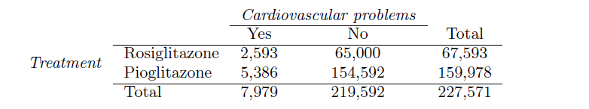
Contingency Table
In a nationwide retrospective observational study of 227,571 Medicare beneficiaries aged 65 years or older, it was found that 2,593 of the 67,593 patients using rosiglitazone and 5,386 of the 159,978 using pioglitazone had serious cardiovascular problems.

Slide 4
(a) Determine if each of the following statements is true or false.
Since more patients on pioglitazone had cardiovascular problems (5,386 vs. 2,593), we can conclude that the rate of cardiovascular problems for those on a pioglitazone treatment is higher.
Answer: FALSE. By converting the continency table to percentages, we see that pioglitazone actually has a lower rate of cardio vascular disease.
Cardiovascular problems
 | Yes | No | Total
Rosiglitazone | 0.0384 | 0.9616 | 1.00
Pioglitazone | 0.0337 | 0.9663 | 1.00
Total | 0.0351 | 0.9649 | 1.00

Slide 5
(a) Determine if each of the following statements is true or false.
The data suggest that diabetic patients who are taking rosiglitazone are more likely to have cardiovascular problems since the rate of incidence was (2,593 / 67,593 = 0.038) 3.8% for patients on this treatment, while it was only (5,386 / 159,978 = 0.034) 3.4% for patients on pioglitazone.
Answer: TRUE The data does show that a slightly higher percentage of Rosiglitazone patients have cardiovascular problems.

Slide 6
(a) Determine if each of the following statements is true or false.
The fact that the rate of incidence is higher for the rosiglitazone group proves that rosiglitazone causes serious cardiovascular problems.
Answer: FALSE. At best, the study shows Correlation, and that alone does not prove causation.

Slide 7
(a) Determine if each of the following statements is true or false.
Based on the information provided so far, we cannot tell if the difference between the rates of incidences is due to a relationship between the two variables or due to chance.
Answer: TRUE. We would need more in-depth information about the study, i.e. it’s collection methods

Slide 8
(b) What proportion of all patients had cardiovascular problems?
Answer: There were 7,979 with cardiovascular problems or 3.51%

Slide 9
(c) How many patients in the rosiglitazone group would we expect to have had cardiovascular problems
Answer: If the type of treatment and having cardiovascular problems were independent, about how many patients in the rosiglitazone group would we expect to have had cardiovascular problems?
By taking the total number of rosiglitazone patients, 67,593 and multiplying that by the percentage of cardiovascular problems in the study 7979/227571, we can expect 2,370 patients in the rosiglitazone group to have cardiovascular problems.

Slide 10
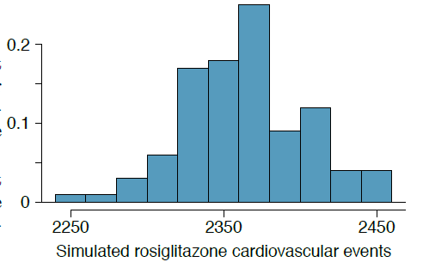
(d) Independence Simulation

Slide 11
(d) i Claims Being Tested
H0 : The treatment Rosiglitazone is independent to cardiovascular problems. Any correlation is due to chance.
HA: The treatment Rosiglitazone is not independent to cardiovascular problems. There’s a correlation between Rosiglitazone and an increased chance of cardiovascular problems.

Slide 12
(d) ii Support for the Alt Hypothesis
Compared to the number calculated in part (b), which would provide more support for the alternative hypothesis, more or fewer patients with cardiovascular problems in the rosiglitazone group?
Answer: More patients with cardiovascular problems in the rosiglitazone group in the rosiglitazone group would give more support to the alternative hypothesis.
It would show a higher correlation between the treatment and cardiovascular problems, and that there was no independence.

Slide 13
(d) iii The Independence Simulations
2,593 patients in the rosiglitazone group had cardiovascular problems
In the independence simulations, reproduced less than the 2593 in every single simulations
Suggest that rosiglitazone treatment is not independent of cardiovascular disease
Hence, we reject the null hypothesis in favor of the alternative hypothesis

